Slide 1
Real-time speaker Recognizer
Offline and real-time speaker diarization system
Author: Hao Pan Supervisor: Dr. Beta C.L. Yip

Slide 2
Introduction
Objectives
Scope

Slide 3

Introduction - Speaker diarization
Speaker diarization: partition an input audio stream into homogeneous segments according to speaker identity
Answer question “who spoke when”
2 Types:
Offline:
Access to whole audio;
perform clustering after all segments are registered
Online:
Strict left-to-right fashion

Slide 4
Problems in existing system
Lack of real-time system
Require Intensive computation & long processing time
Online clustering performance are much worse than offline clustering
Many system are domain-specific

Slide 5
Objectives
Develop a speaker diarization system:
[Offline Version]: label the speakers in a recorded audio and visualize the results
[Realtime Version]: generate outputs as the input is analyzed and correct the earlier output when necessary
[Other requirements]:
Language-independent;
domain-robust;
Platform-independent;
Do not need prior training

Slide 6
System workflow
Voice Activity Detection, Feature extraction
KBM Training
Feature Representation
Clustering
Resegmentation
(Optional)
Visualization

Slide 7
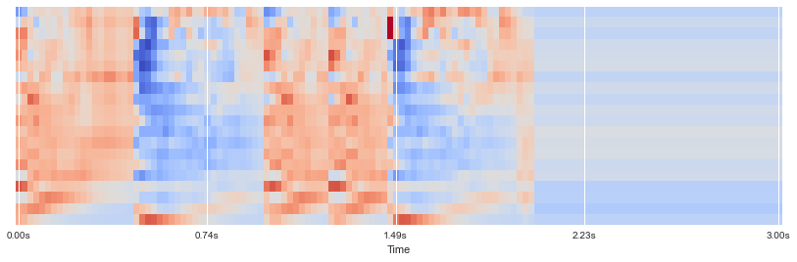
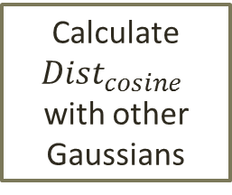
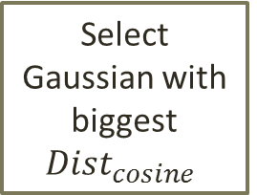
KBM Training
Features (MFCCs)
Speaker acoustic space
Sliding Windows
KBM
……
Gaussian
Pool
……
most complementary & discriminant Gaussians
Stop when getting N Gaussians
Select 1st Gaussian with max likelihood
Calculate ${Dist}_{cosine}$
with other Gaussians
Select Gaussian with biggest ${Dist}_{cosine}$

Slide 8
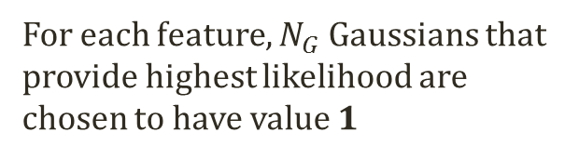
Feature representation
Features of utterance
(segments)
m features vectors
Cumulative Vector (CV)
Binary Key (BK)
Count
Occurrences
0
1
0
1
0
1
0
0
15
1
0
0
1
7
1 for top 20% values in CV
0
N Gaussians
in KBM
0
1
……
0
3
0
1
0
1
25
1
0
1
0
5
0
…
…
…
…
1
0
1
17
1
For each feature, $N_{G}$ Gaussians that provide highest likelihood are chosen to have value 1
Segment/cluster
representation

Slide 9
Real-time system
Offline
Thread 1
Thread 2
KBM Training
Compute representation for all features
Offline clustering
All Data
Results
VAD,
Feature extraction
Compute representation for new features
Online clustering
New Data
Online

